Slide 1
Network Proposal
Cadets William Born and Kayleigh Stallings

Slide 2
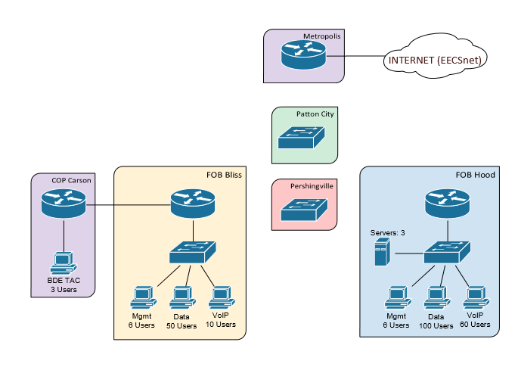
Network Overview

Slide 3
Requirements
All users need internet access
If a link is cut between FOB Bliss and Pershingvill, FOB Bliss should sill have access to all other sites
BDE TAC wants Wi-Fi
Internal users have access to 2 web servers and a DNS server
Only appropriate traffic should be sent to each server
No users from the outside should be able to access the servers or ping the network

Slide 4
Constraints
IP Space= 10.64.62.0/24
Metropolis router IP = 10.64.0.62/24
OSPF must be used between main sites and COP

Slide 5
Network Diagram

Slide 6
Subnetting Chart

Slide 7
Interface Configuration

Slide 8
VLAN Configuration

Slide 9
Routing

Slide 10
ACLS, NAT and wireless

Slide 11
Layer 2 design

Slide 12
Layer 3 Design

